Slide 1
Programming Languages -1
(Introduction to C) arrays
Instructor: M.Fatih AMASYALI
E-mail:mfatih@ce.yildiz.edu.tr

Slide 2
One-Dimensional Arrays
Often, programs use homogeneous data. As an example, if we want to manipulate some grades, we might declare
int grade0, grade1, grade2;
If we have a large number of grades, it becomes cumbersome to represent/manipulate the data using unique identifiers.
Arrays allow us to refer to a large number of the same data type using a single name. For instance,
int grade[3];

Slide 3
One-Dimensional Arrays
Makes available the use of integer variables grade[0], grade[1], grade[2] in a program.
Declaration syntax:
Type array_name[number_of_elements]
WARNING: arrays are zero-indexed (numbering always starts at 0).
Now, to access elements of this array, we can write grade[expr],
Example:
for( i = 0; i < 3; i++ )
sum += grade[i];

Slide 4
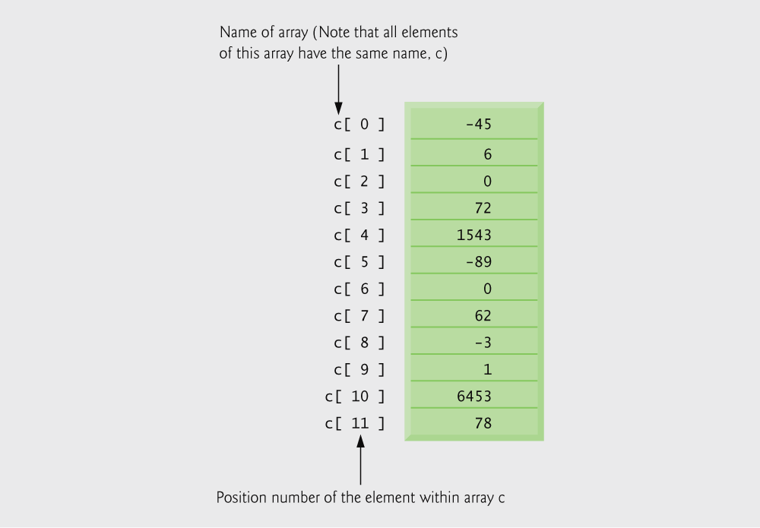

Slide 5
Initializers
    int n[ 5 ] = { 1, 2, 3, 4, 5 };
  If not enough initializers, rightmost elements become 0
      int n[ 5 ] = { 0 }
    All elements 0
  If too many initializers, a syntax error occurs
  C arrays have no bounds checking
If size omitted, initializers determine it
    int n[ ] = { 1, 2, 3, 4, 5 };
  5 initializers, therefore 5 element array

Slide 6
Initializers
  If there are fewer initializations than elements in the array, then the remaining elements are automatically initialized to 0.
  int n[5] = {0}
  /* All elements 0 */
  int a[10] = {1, 2}
  /* a[2] to a[9] are initialized to zeros */
  int b[5] = {1, 2, 3, 4, 5, 6}
  /* syntax error */

Slide 7
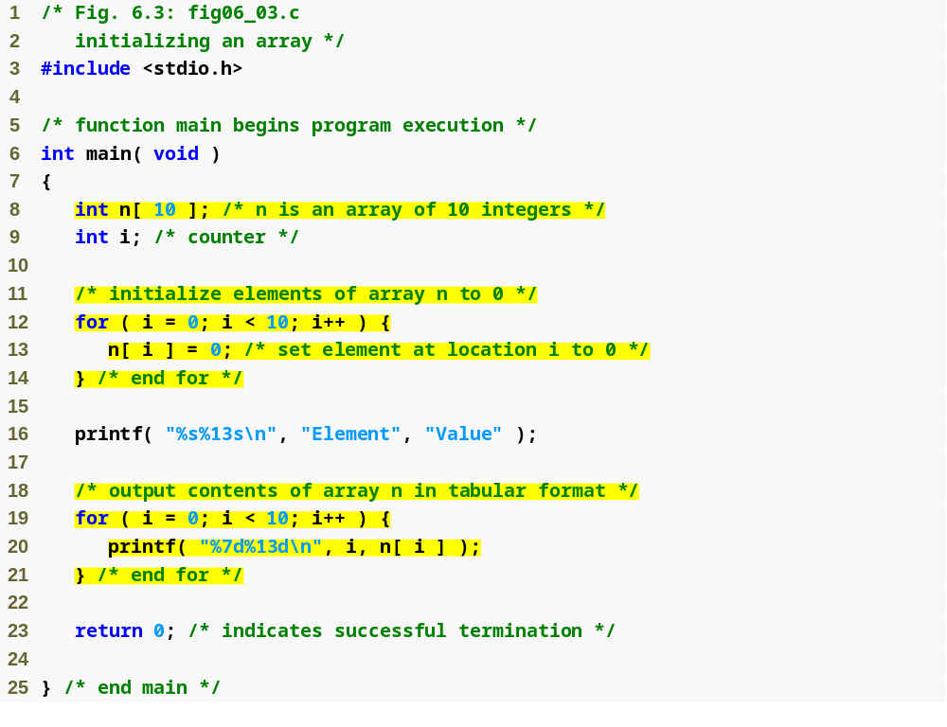
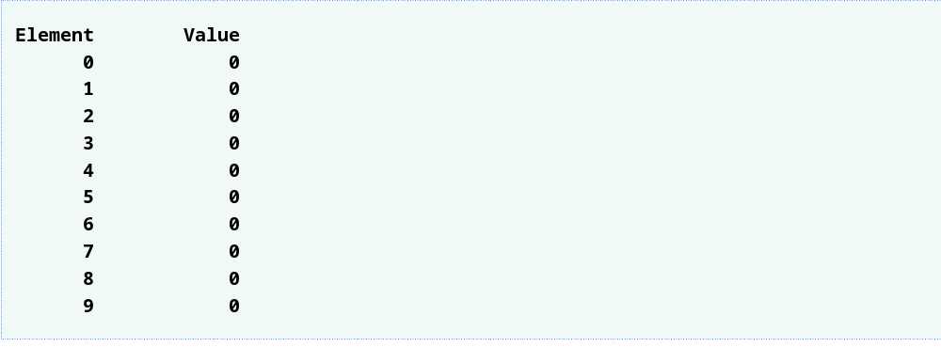
for loop initializes each array element separately
for loop outputs all array elements

Slide 8
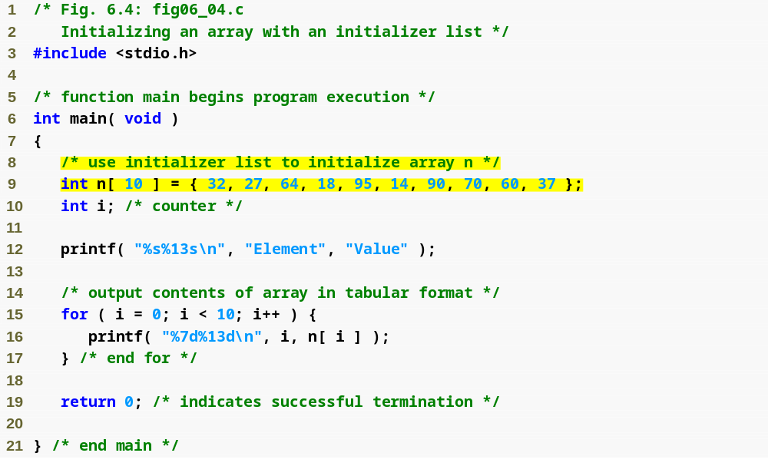
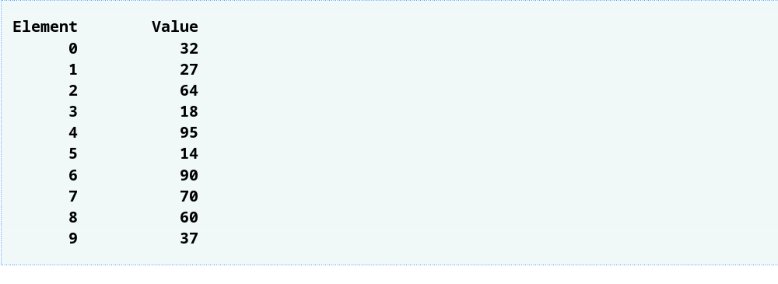
initializer list initializes all array elements simultaneously

Slide 9
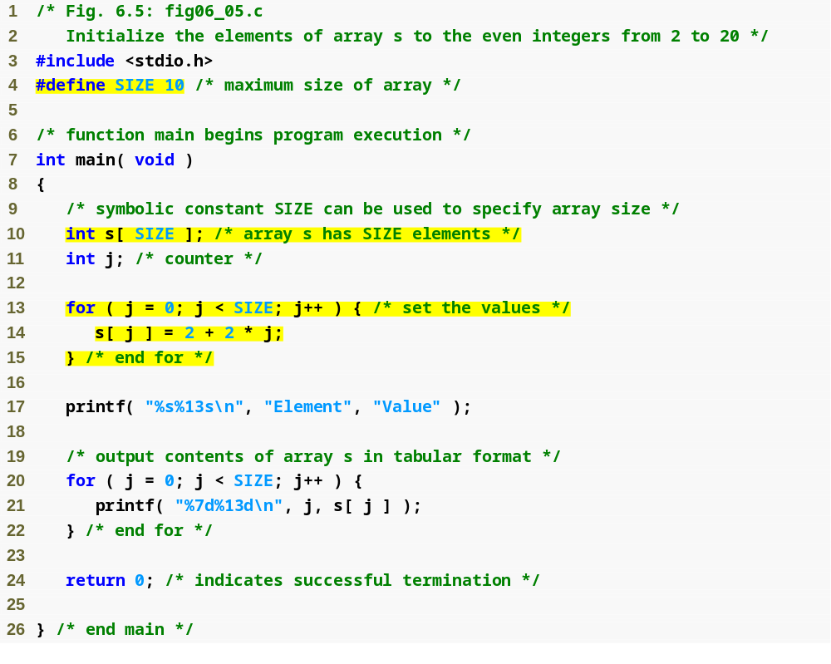
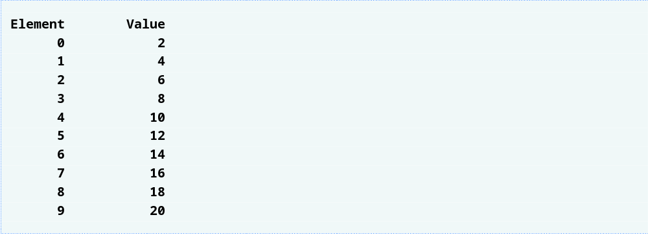
#define directive tells compiler to replace all instances of the word SIZE with 10
SIZE is replaced with 10 by the compiler, so array s has 10 elements
for loop initializes each array element separately
Defining the size of each array as a symbolic constant makes programs more scalable.

Slide 10
Tip
Use only uppercase letters for symbolic constant names. This makes these constants stand out in a program and reminds you that symbolic constants are not variables.

Slide 11
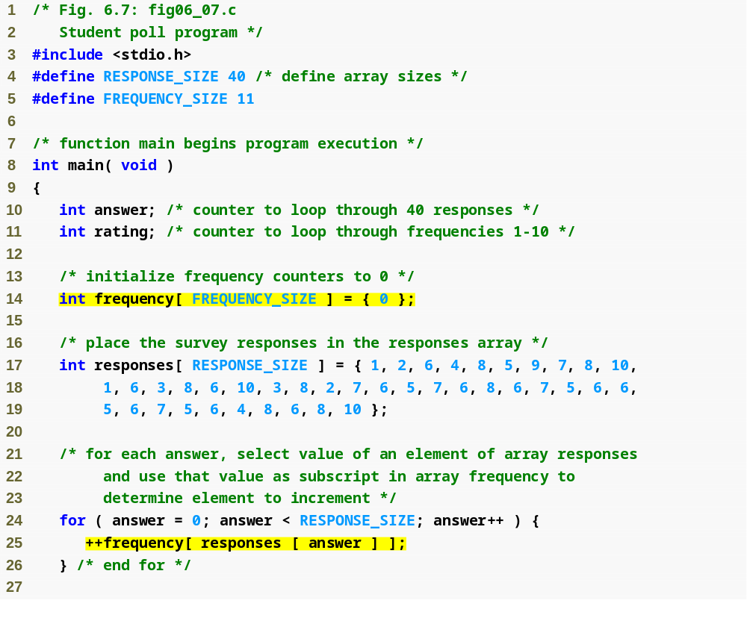
#define directives create symbolic constants
frequency array is defined with 11 elements
responses array is defined with 40 elements and its elements are initialized
subscript of frequency array is given by value in responses array

Slide 12
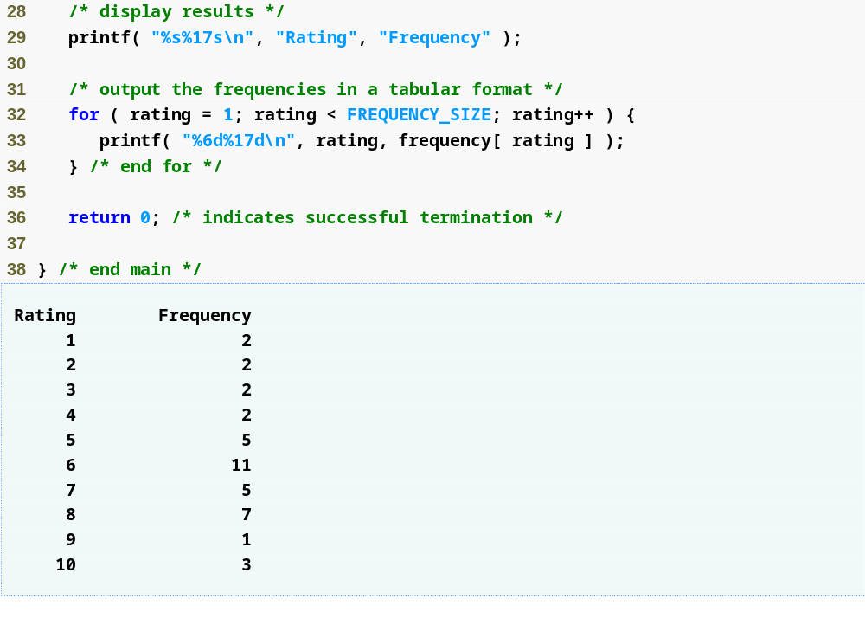

Slide 13
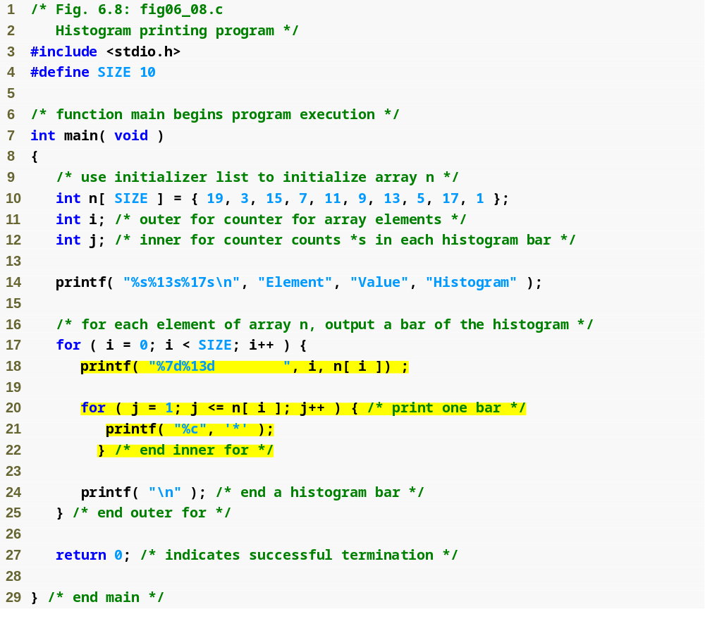
nested for loop prints n[ i ] asterisks on the ith line

Slide 14
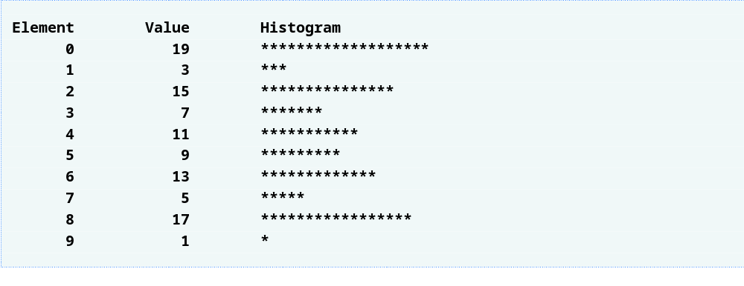

Slide 15
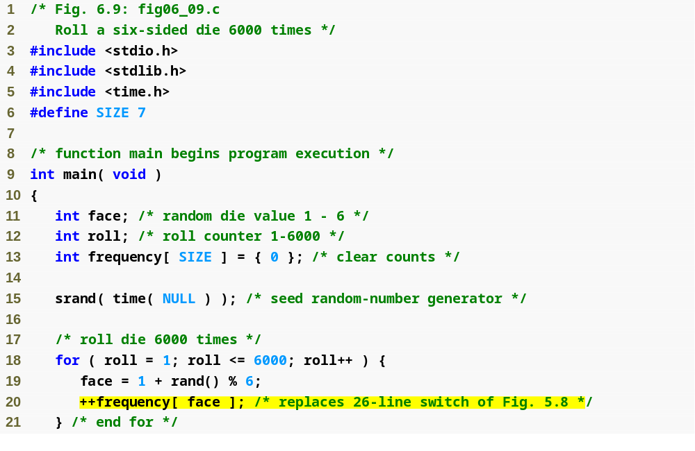
for loop uses one array to track number of times each number is rolled instead of using 6 variables and a switch statement

Slide 16
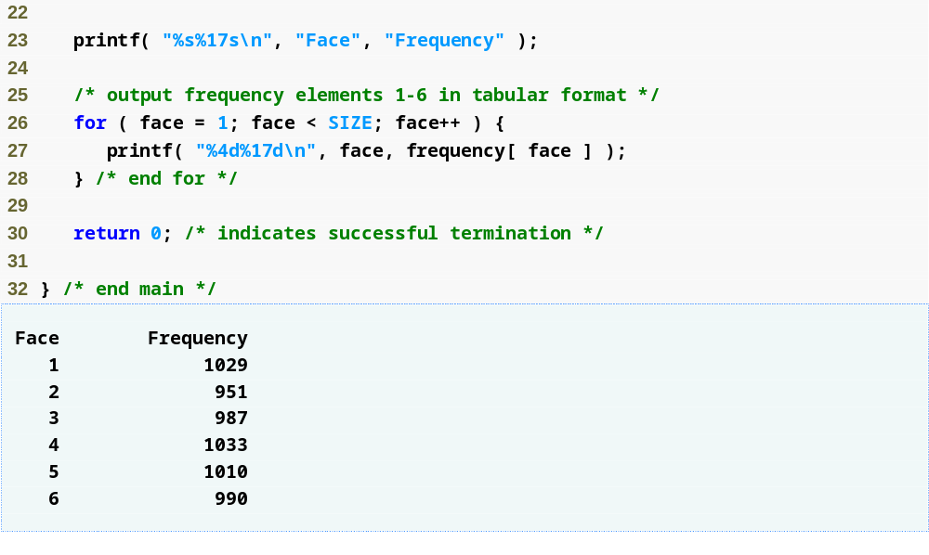

Slide 17
Character arrays
  Character arrays can be initialized using string literals
      char string1[] = "first";
    Null character '\0' terminates strings
    string1 actually has 6 elements
      It is equivalent to
  char string1[] = { 'f', 'i', 'r', 's', 't', '\0' };
  Can access individual characters
    string1[ 3 ] is character ‘s’
  Array name is address of array, so & not needed for scanf
      scanf( "%s", string2 );
    Reads characters until whitespace encountered
    Be careful not to write past end of array, as it is possible to do so

Slide 18
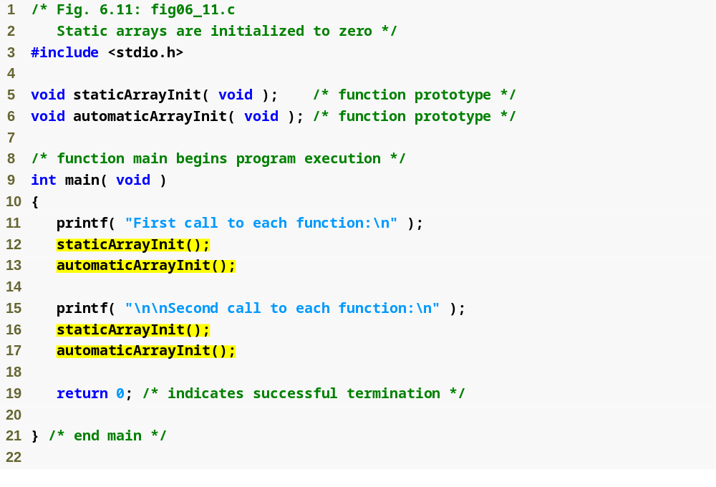

Slide 19
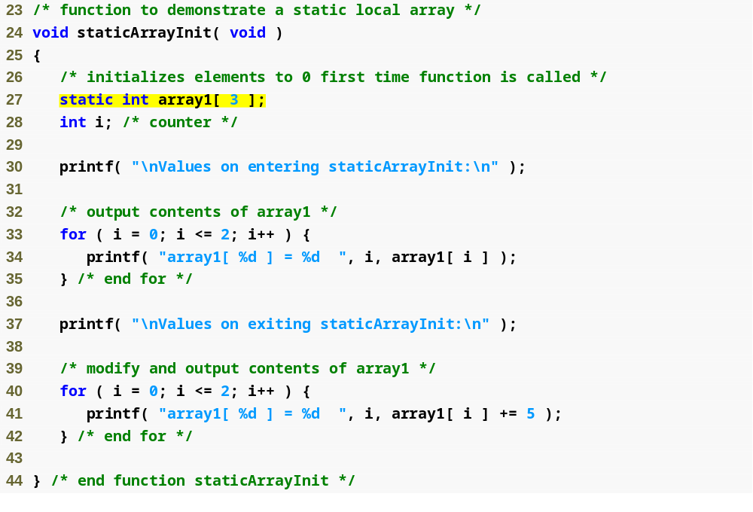
static array is created only once, when staticArrayInit is first called

Slide 20
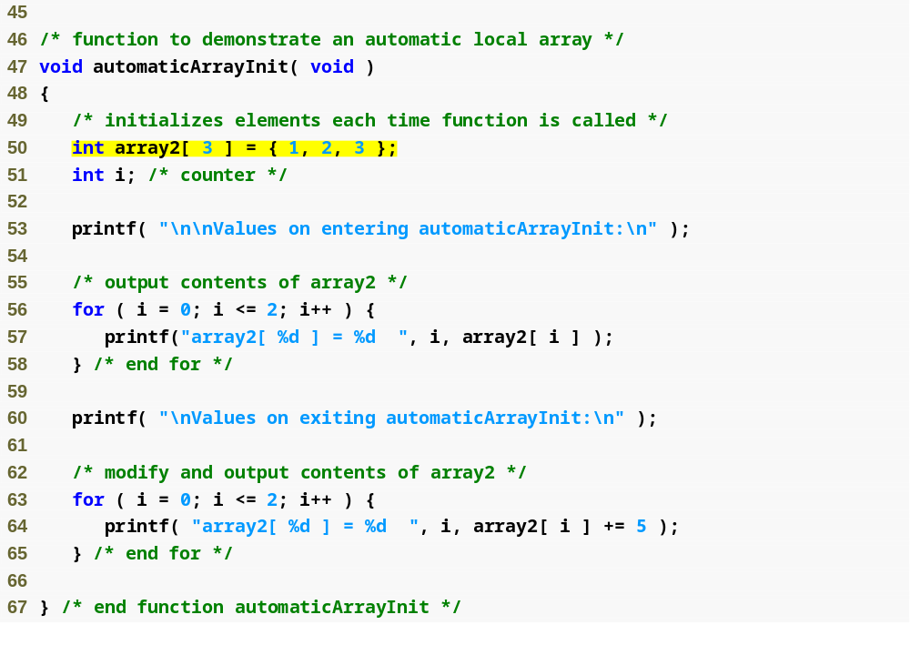
automatic array is recreated every time automaticArrayInit is called

Slide 21
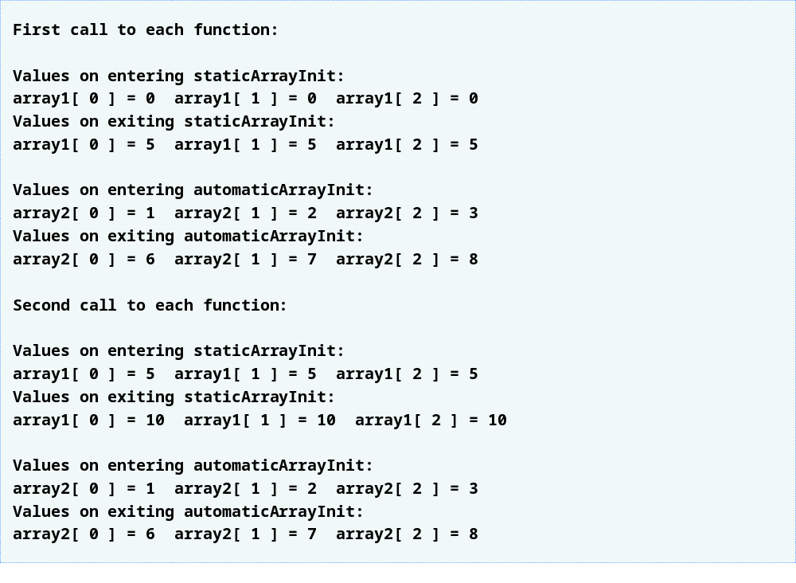

Slide 22
Passing arrays
  To pass an array argument to a function, specify the name of the array without any brackets
      int myArray[ 24 ];
      myFunction( myArray, 24 );
    Array size usually passed to function
  Arrays passed call-by-reference
  Name of array is address of first element
  Function knows where the array is stored
    Modifies original memory locations
Passing array elements
  Passed by call-by-value
  Pass subscripted name (i.e., myArray[ 3 ]) to function

Slide 23
Function prototype
    void modifyArray( int b[], int arraySize );
  Parameter names optional in prototype
    int b[] could be written int []
    int arraySize could be simply int

Slide 24
Tip
Passing arrays by reference makes sense for performance reasons. If arrays were passed by value, a copy of each element would be passed. For large, frequently passed arrays, this would be time consuming and would consume considerable storage for the copies of the arrays.

Slide 25
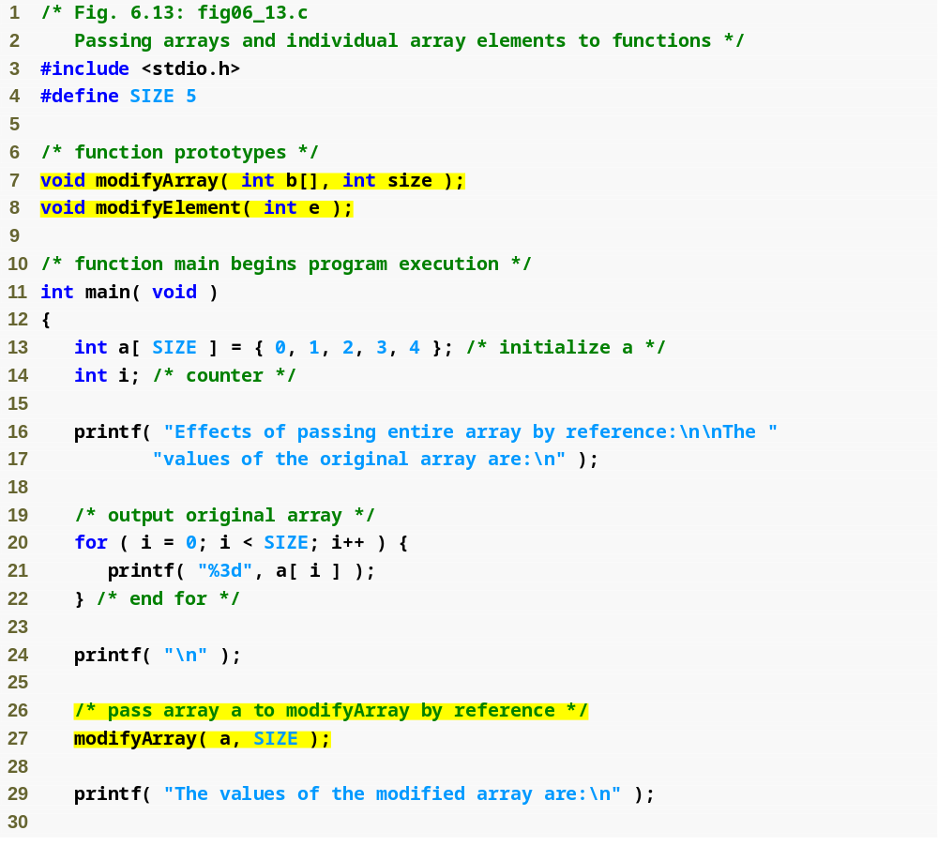
Function prototype indicates function will take an array
Array a is passed to modifyArray by passing only its name

Slide 26
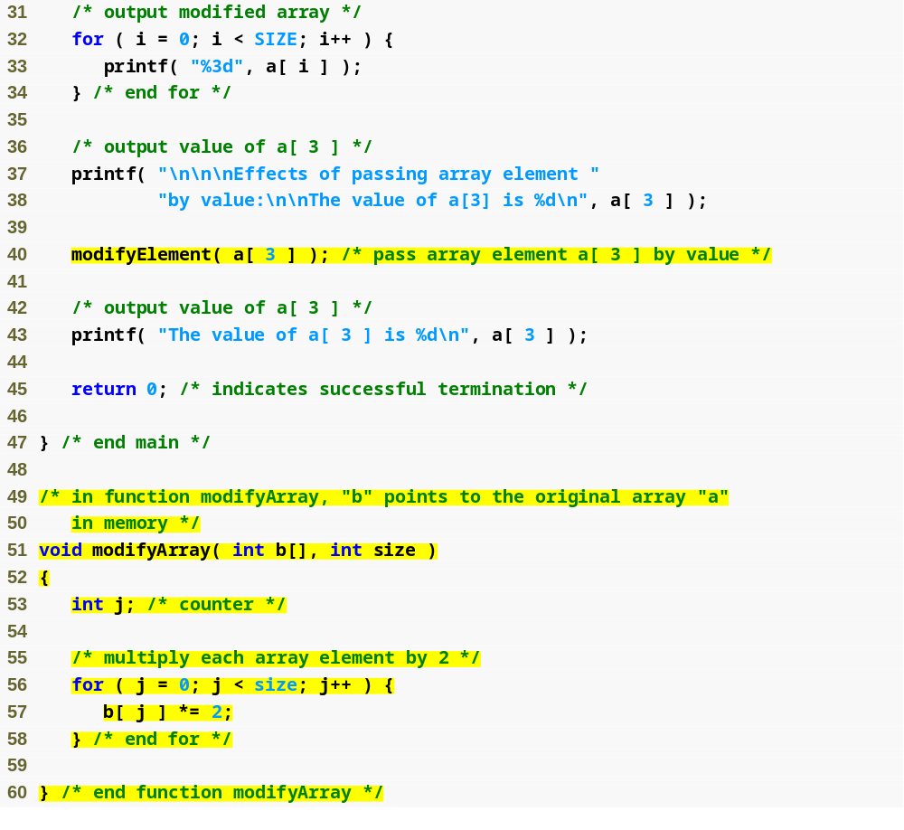
Array element is passed to modifyElement by passing a[ 3 ]

Slide 27
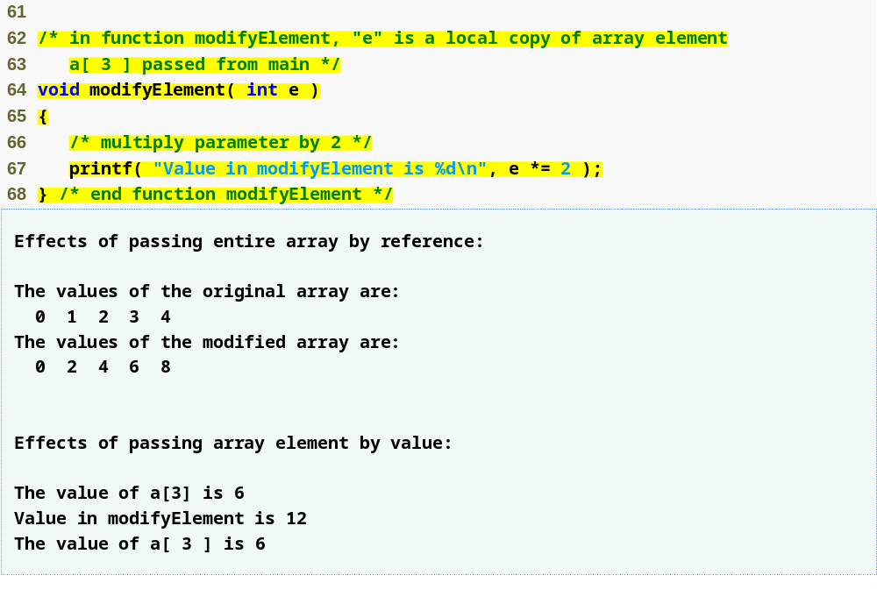

Slide 28
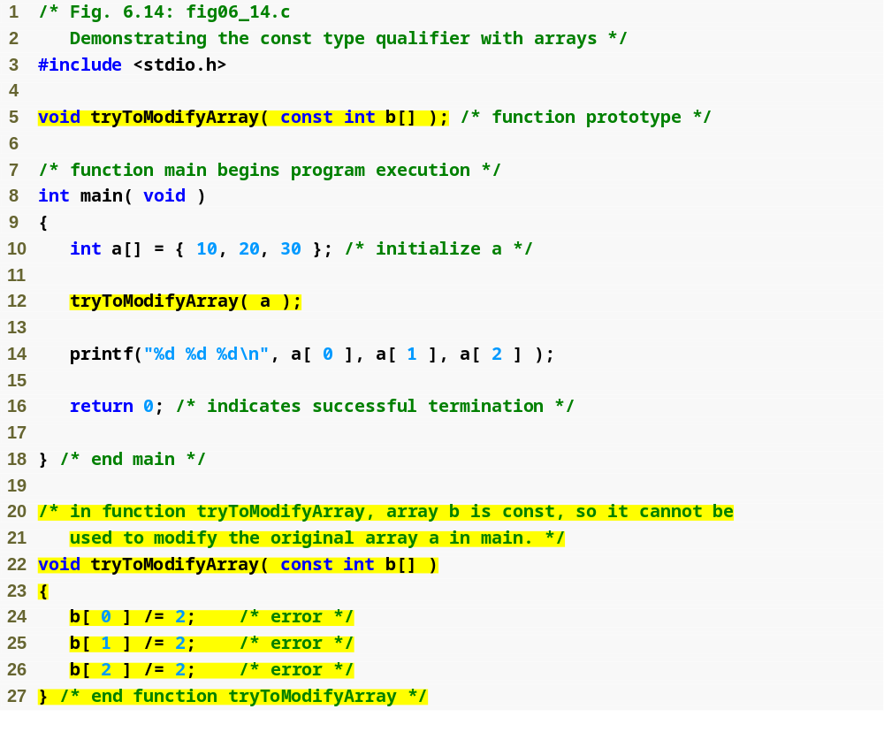
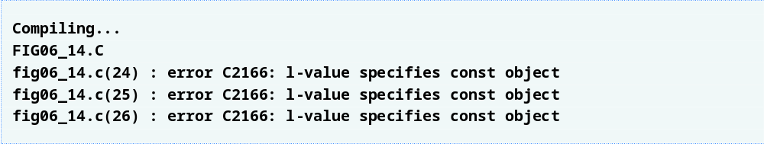
const qualifier tells compiler that array cannot be changed
Any attempts to modify the array will result in errors

Slide 29
Tip
The const type qualifier can be applied to an array parameter in a function definition to prevent the original array from being modified in the function body. Functions should not be given the capability to modify an array unless it is absolutely necessary.

Slide 30
Sorting Arrays
Sorting data
  Important computing application
  Virtually every organization must sort some data
Bubble sort (sinking sort)
  Several passes through the array
  Successive pairs of elements are compared
    If increasing order (or identical ), no change
    If decreasing order, elements exchanged
  Repeat
Example:
  original: 3 4 2 6 7
  pass 1: 3 2 4 6 7
  pass 2: 2 3 4 6 7

Slide 31
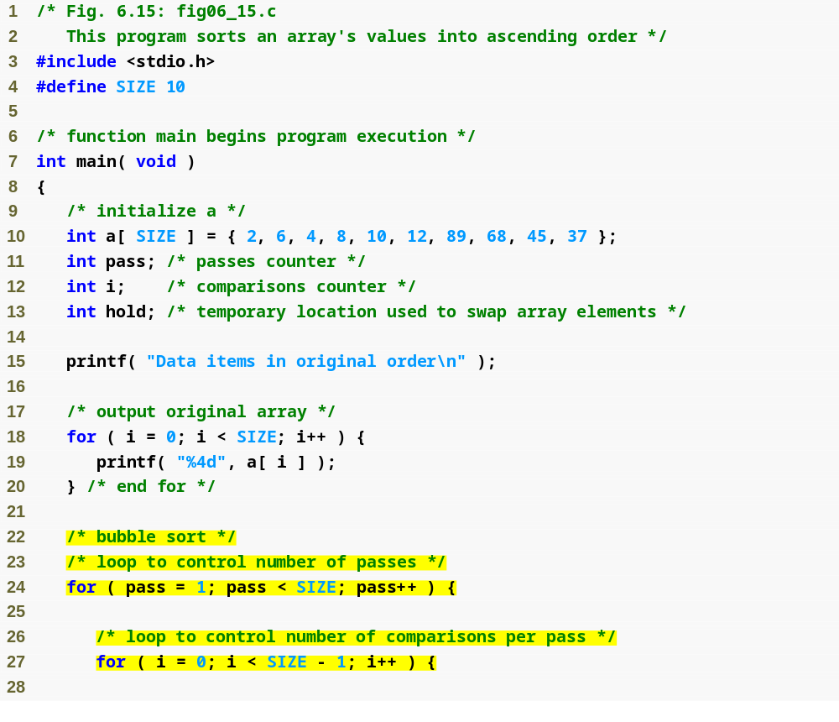

Slide 32
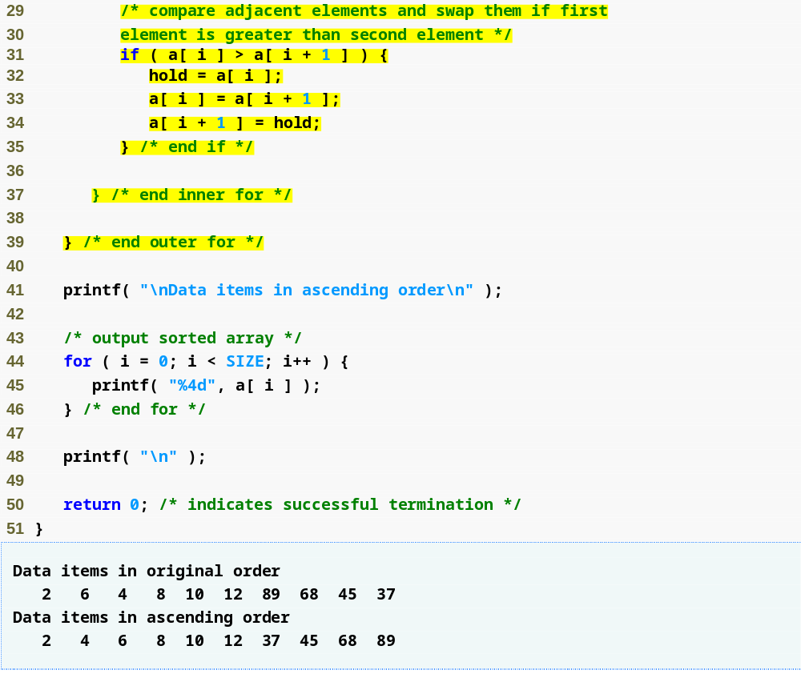
If any two array elements are out of order, the function swaps them

Slide 33
Computing Mean, Median and Mode Using Arrays
Mean – average
Median – number in middle of sorted list
  1, 2, 3, 4, 5
  3 is the median
Mode – number that occurs most often
  1, 1, 1, 2, 3, 3, 4, 5
  1 is the mode

Slide 34
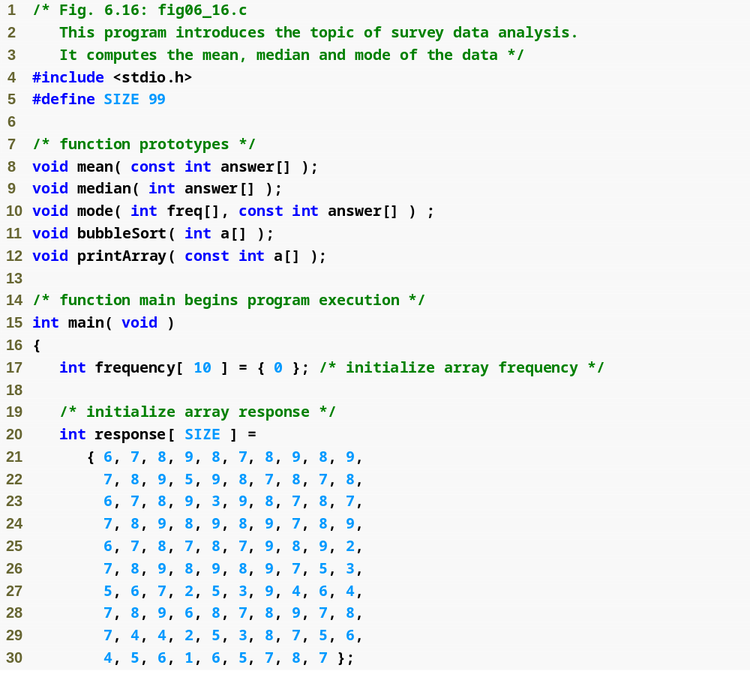

Slide 35
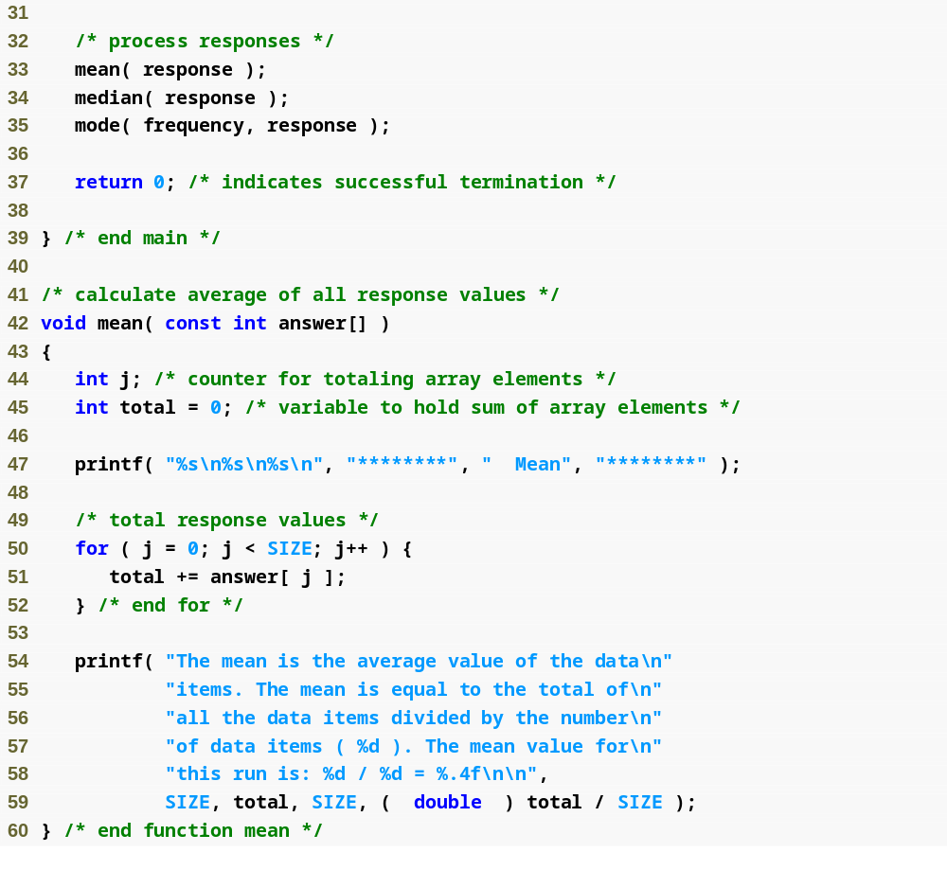

Slide 36
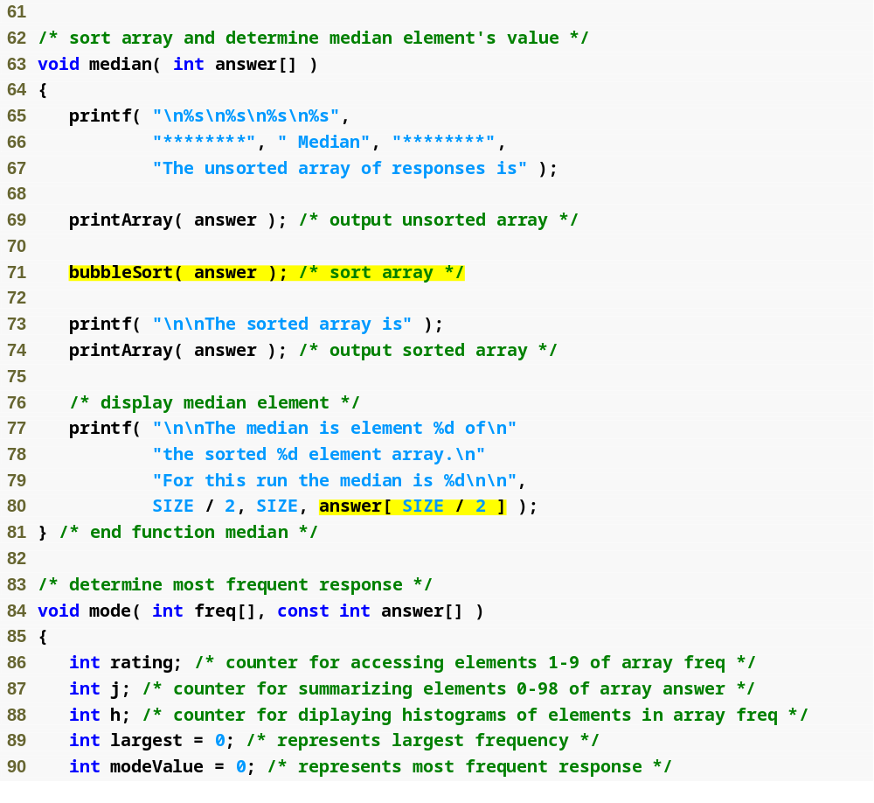
Once the array is sorted, the median will be the value of the middle element

Slide 37
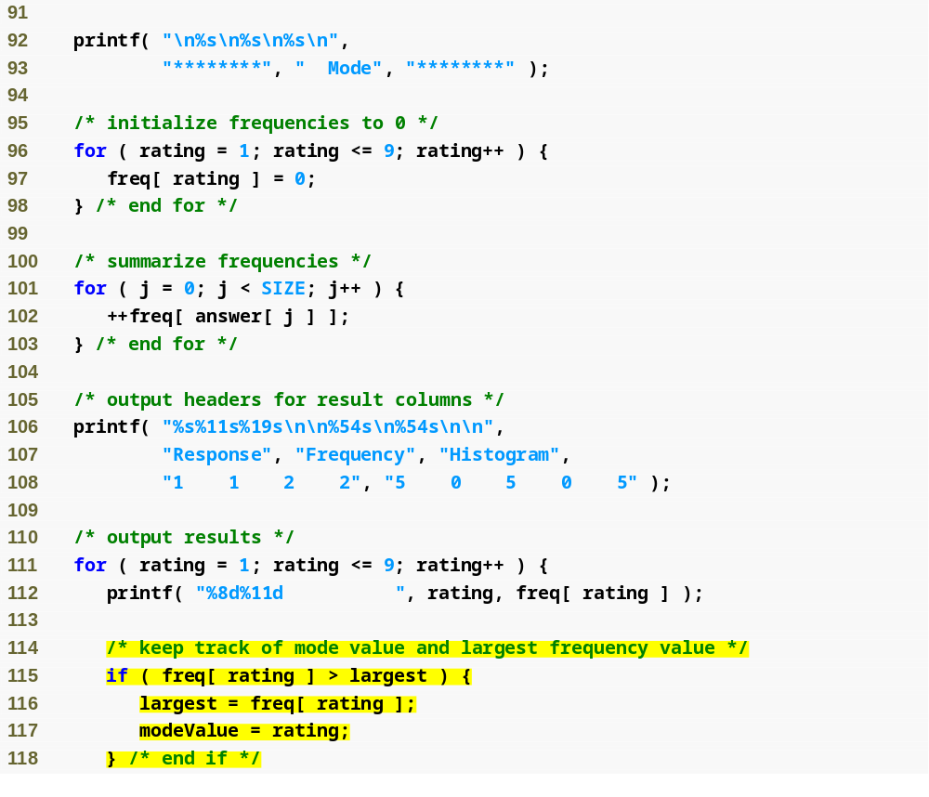

Slide 38
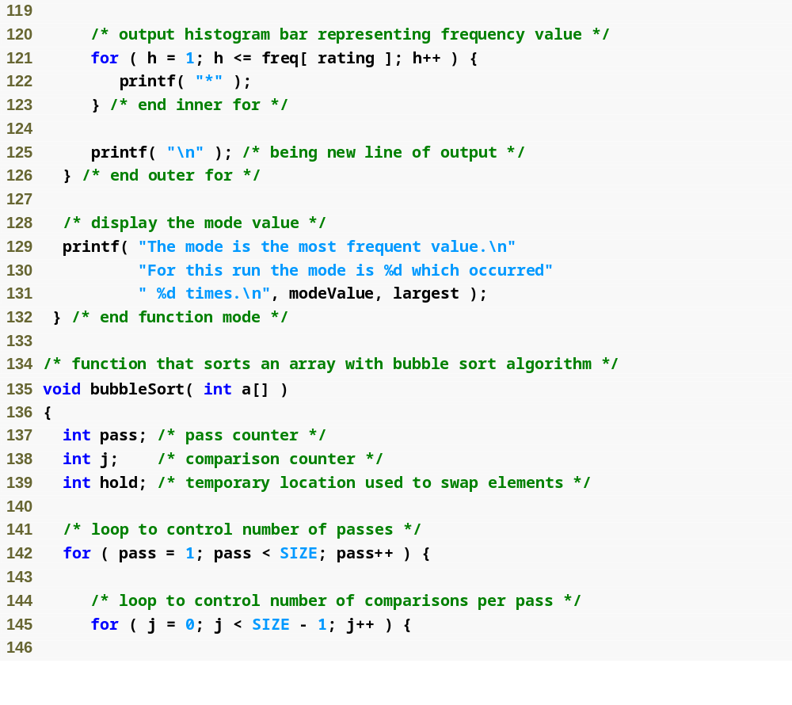

Slide 39
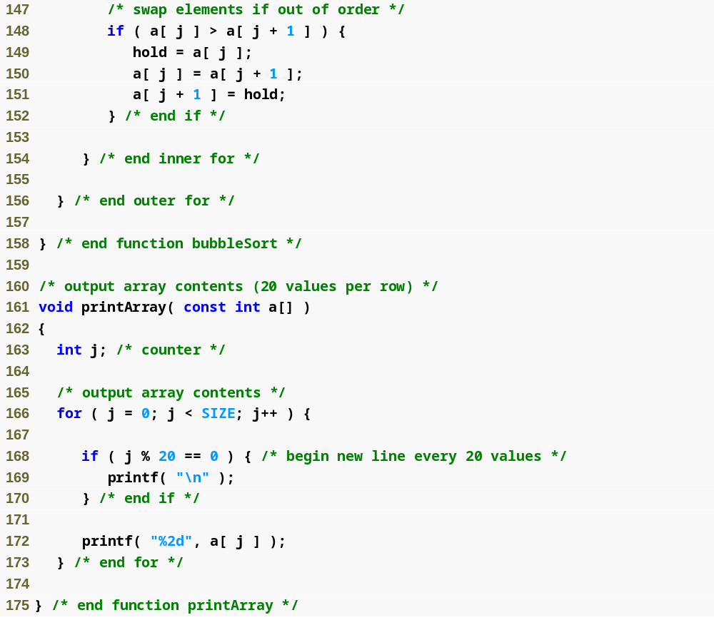

Slide 40
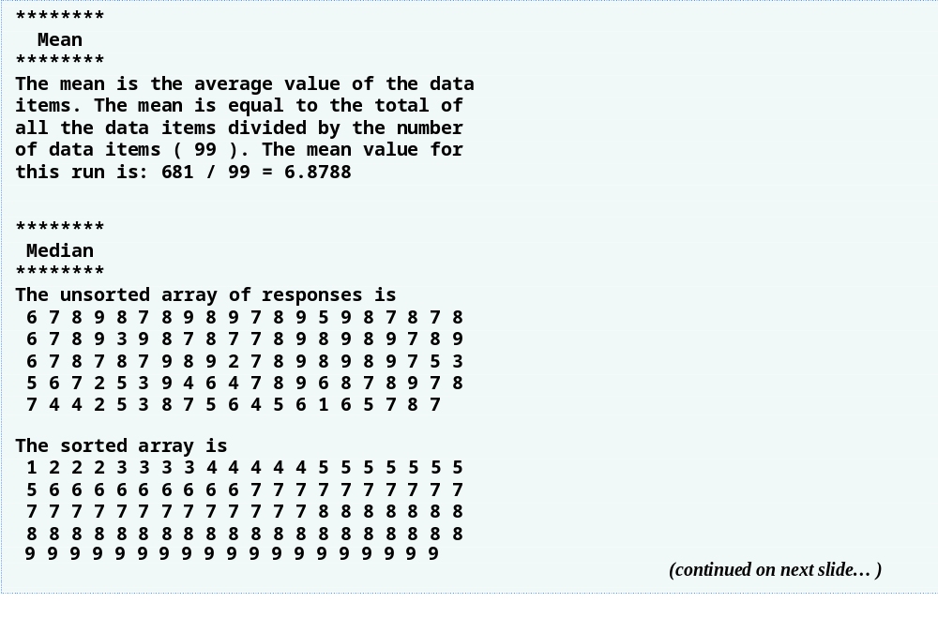

Slide 41
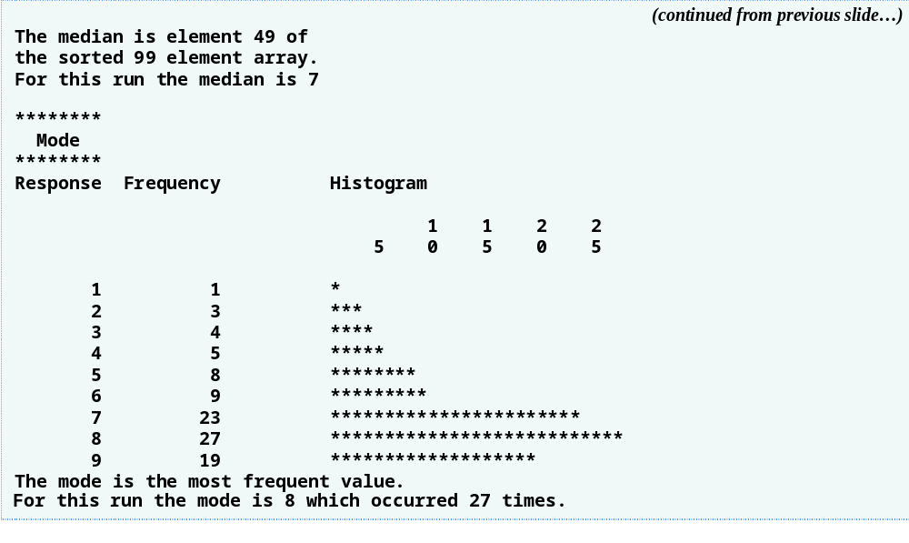

Slide 42
Searching Arrays
Search an array for a key value
Linear search
  Simple
  Compare each element of array with key value
  Useful for small and unsorted arrays

Slide 43
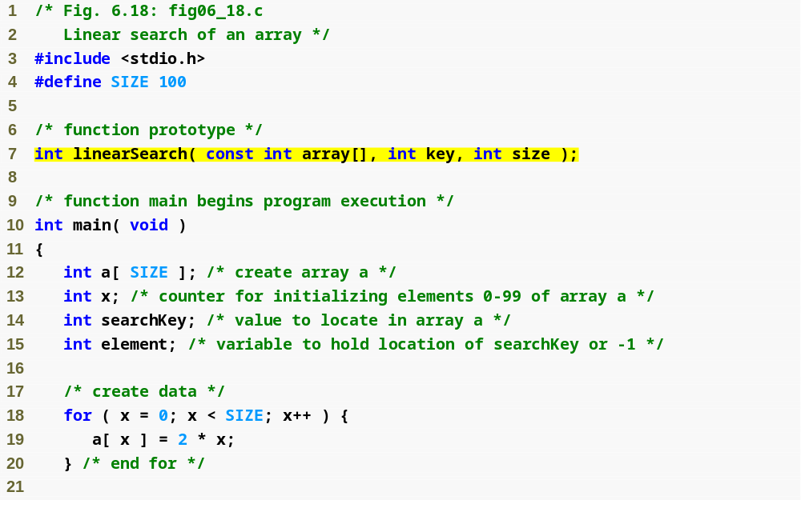

Slide 44
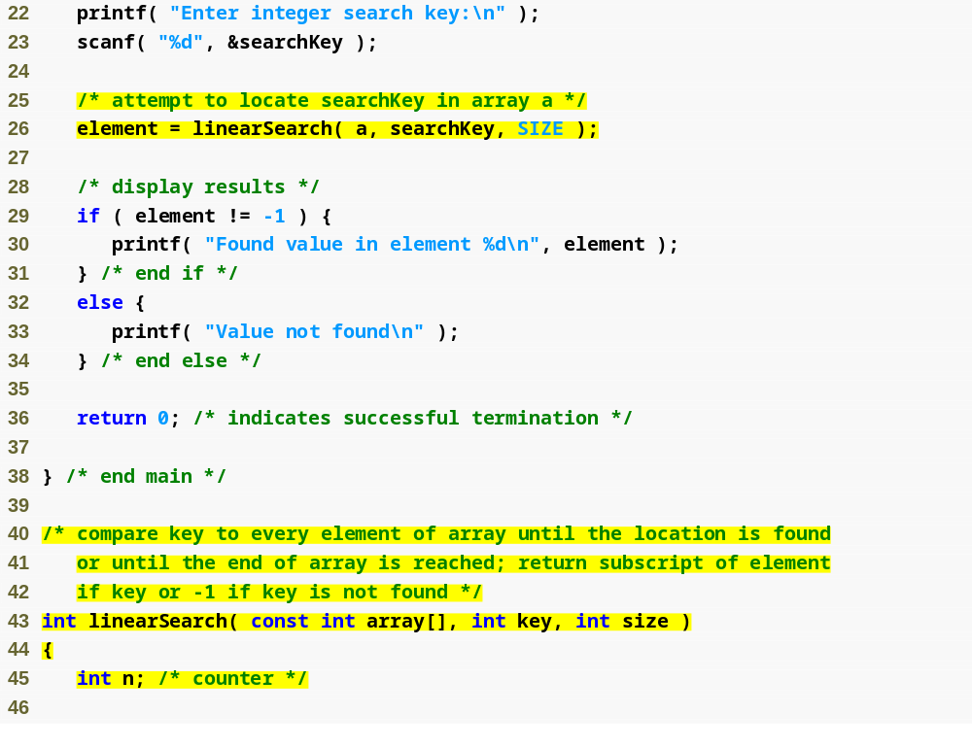

Slide 45
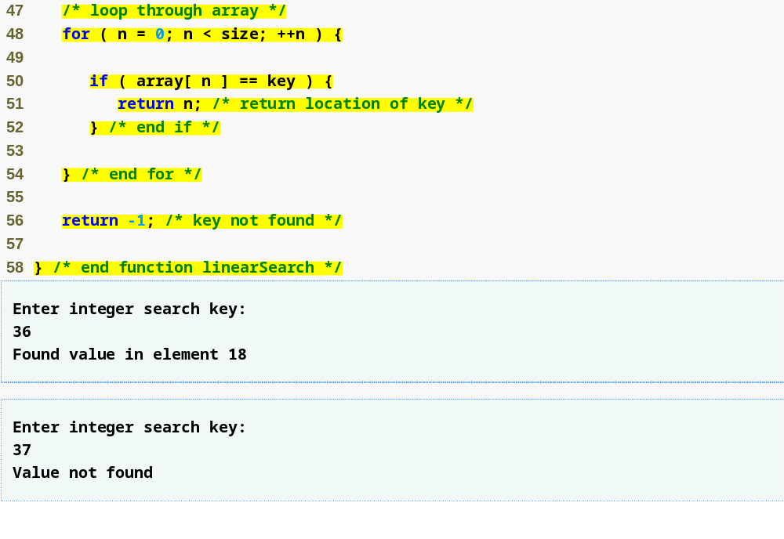
Linear search algorithm searches through every element in the array until a match is found

Slide 46
Searching Arrays
Binary search
  For sorted arrays only
  Compares middle element with key
    If equal, match found
    If key < middle, looks in first half of array
    If key > middle, looks in last half
    Repeat
  Very fast; at most n steps, where 2^{n} > number of elements
    30 element array takes at most 5 steps
      2⁵ > 30 so at most 5 steps

Slide 47
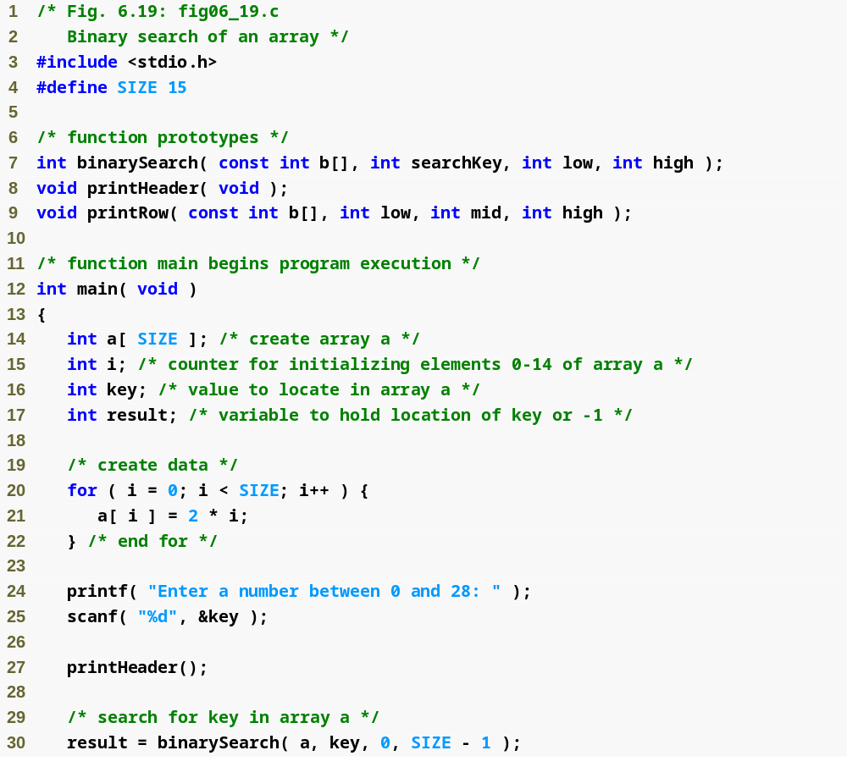

Slide 48
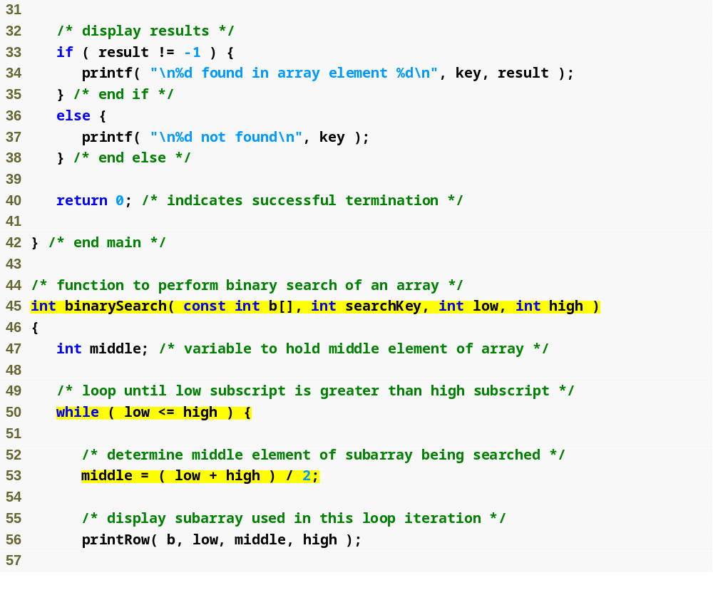

Slide 49
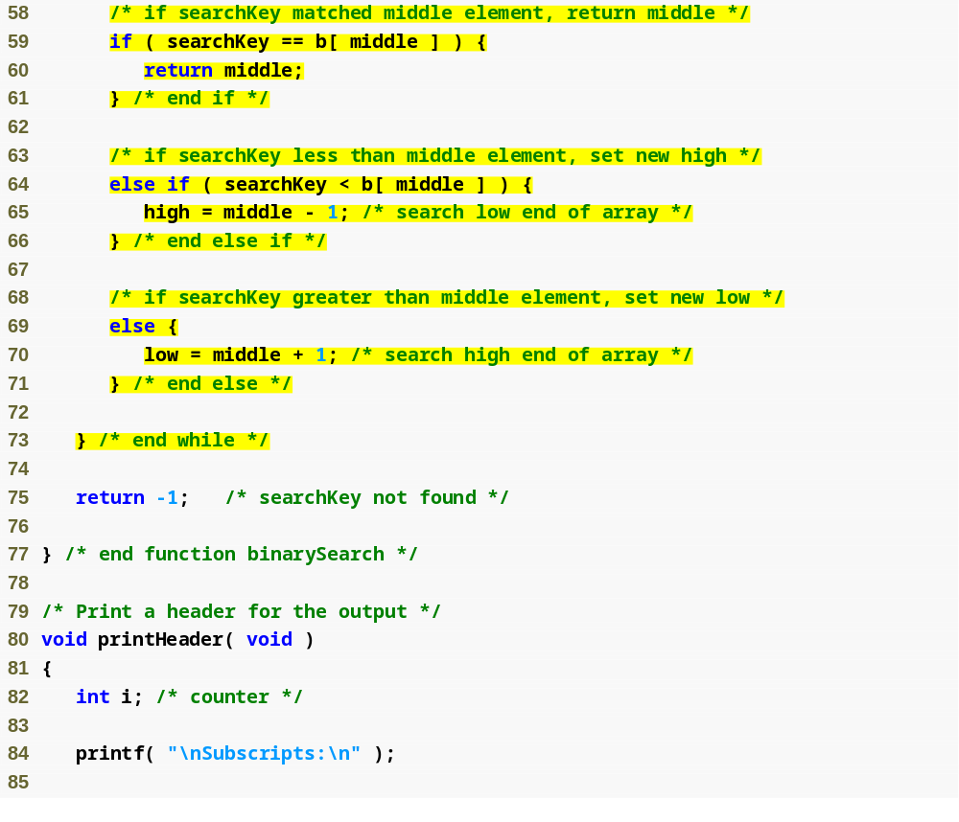
If value is found, return its index
If value is too high, search the left half of array
If value is too low, search the right half of array

Slide 50
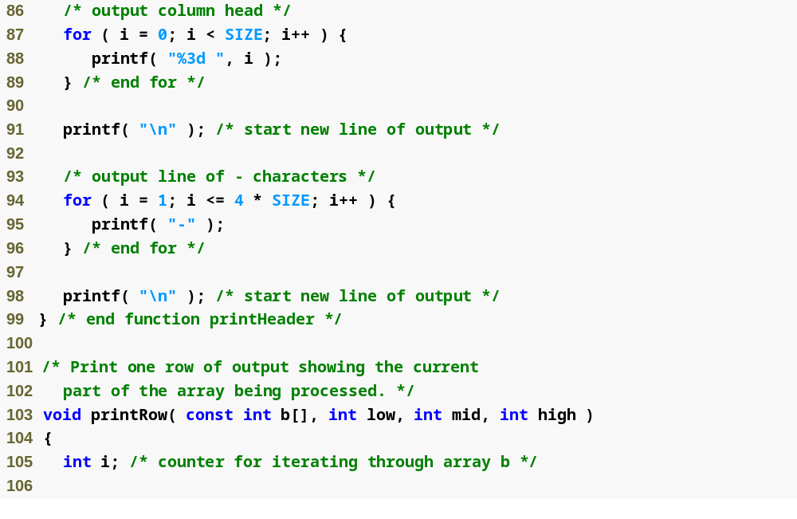

Slide 51
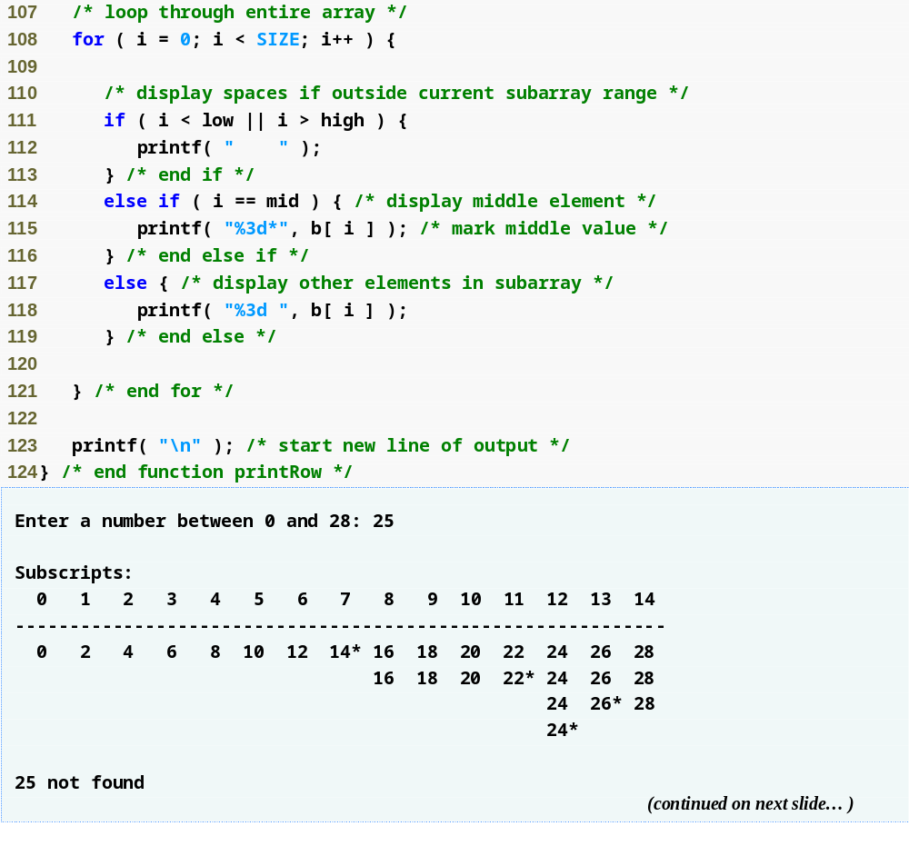

Slide 52
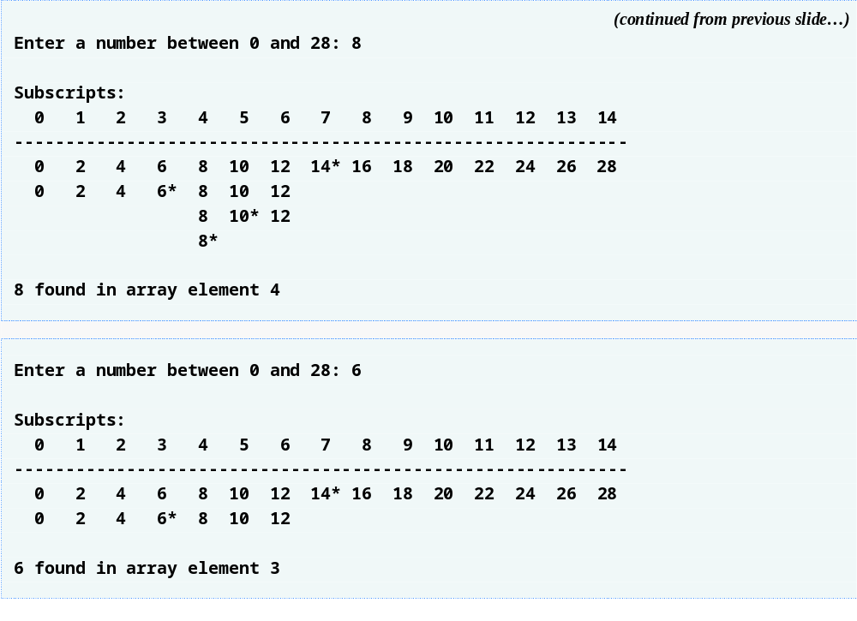

Slide 53
Multiple-Subscripted Arrays
Multiple subscripted arrays
  Tables with rows and columns (m by n array)
  Like matrices: specify row, then column
Initialization
  int b[ 2 ][ 2 ] = { { 1, 2 }, { 3, 4 } };
  Initializers grouped by row in braces
  If not enough, unspecified elements set to zero
    int b[ 2 ][ 2 ] = { { 1 }, { 3, 4 } };
Referencing elements
  Specify row, then column
    printf( "%d", b[ 0 ][ 1 ] );

Slide 54
Tip
Referencing a double-subscripted array element as a[ x, y ] instead of a[ x ][ y ]. C interprets a[ x, y ] as a[ y ], and as such it does not cause a syntax error.

Slide 55
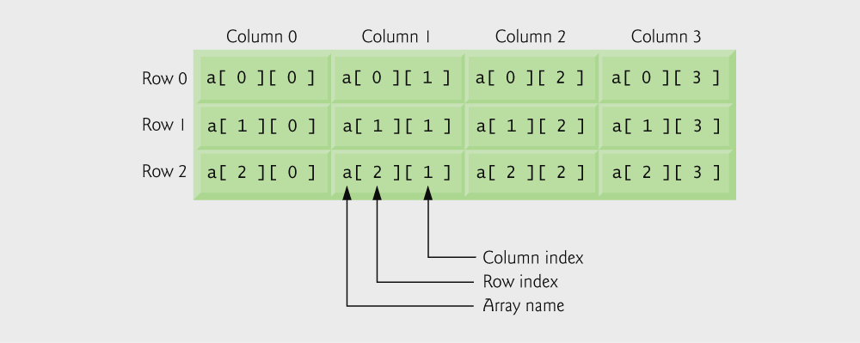
Double-subscripted array with three rows and four columns.

Slide 56
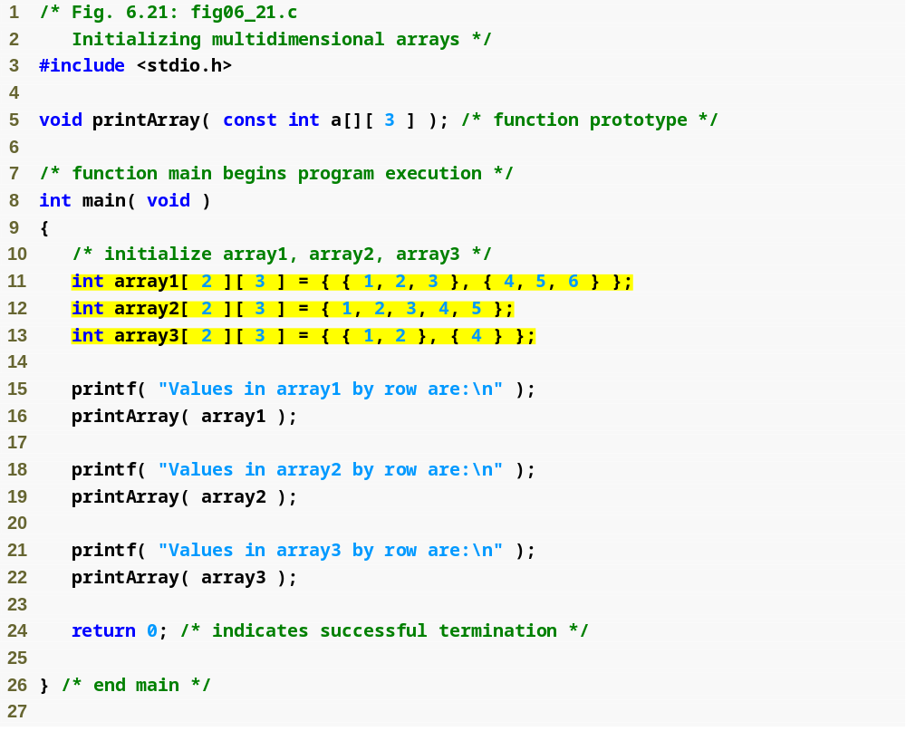
array1 is initialized with both rows full
array2 and array3 are initialized only partially

Slide 57
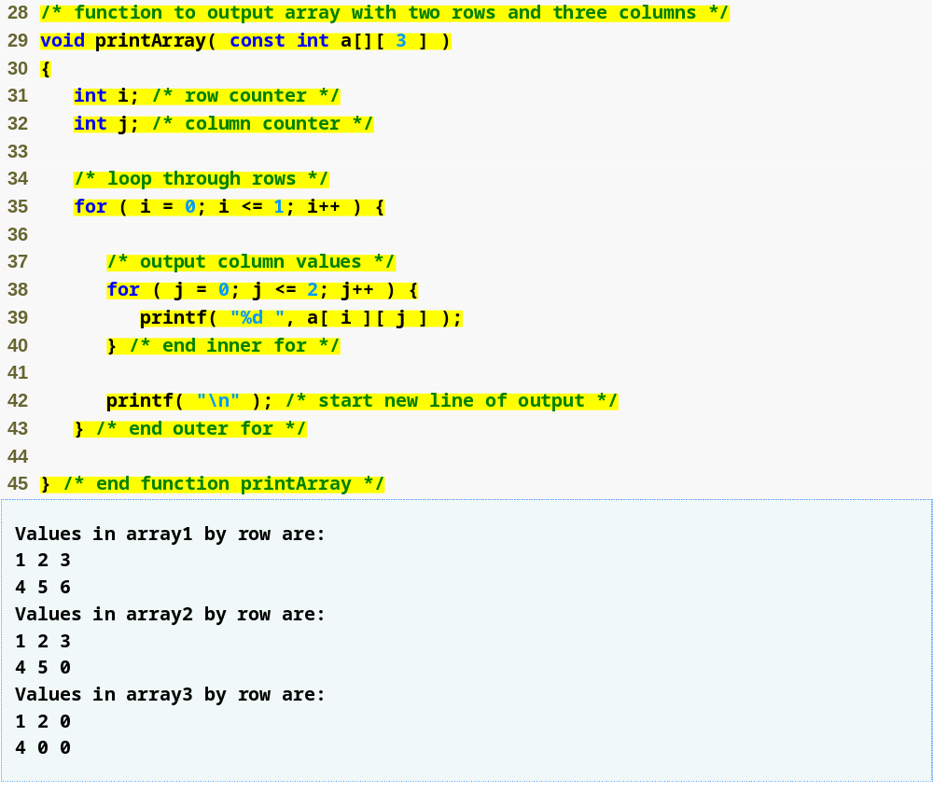

Slide 58
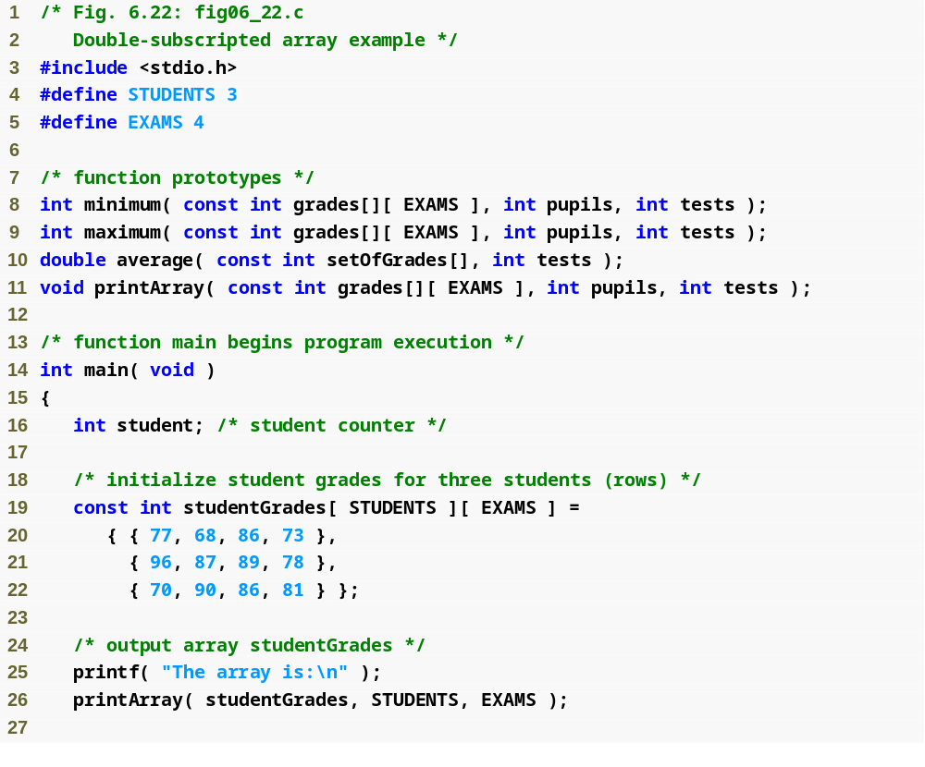
Each row in the array corresponds to a single student’s set of grades

Slide 59
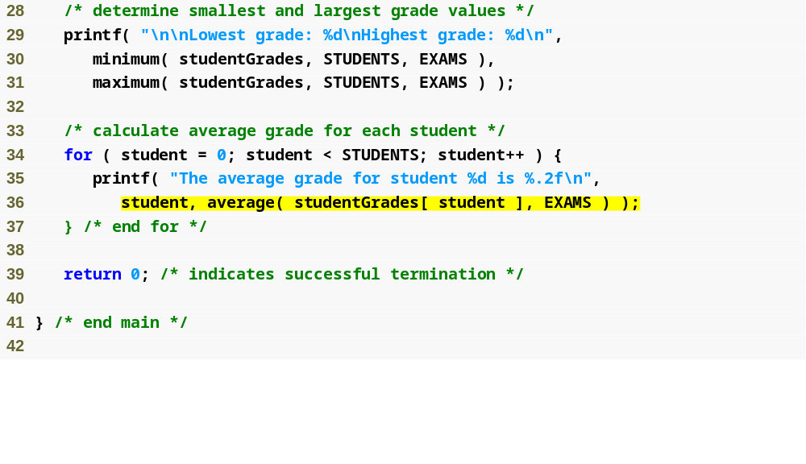
average function is passed a row of the array

Slide 60
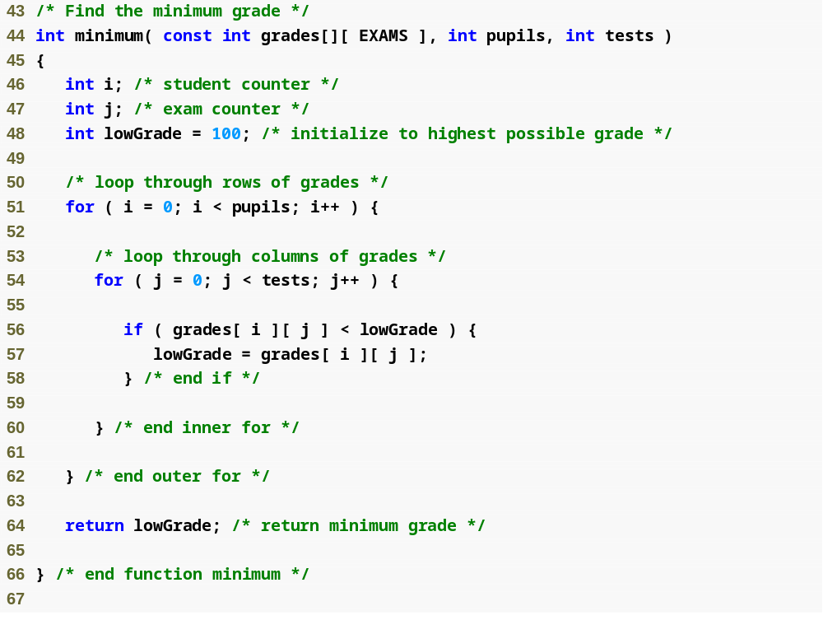

Slide 61
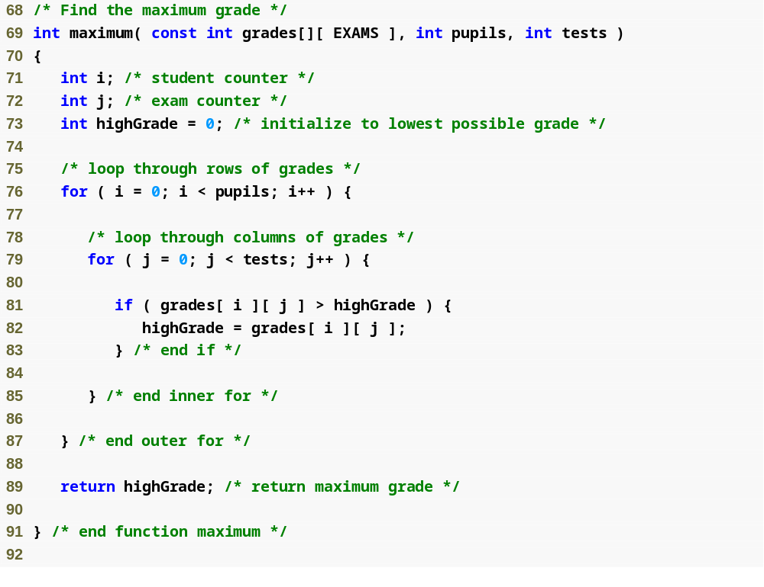

Slide 62
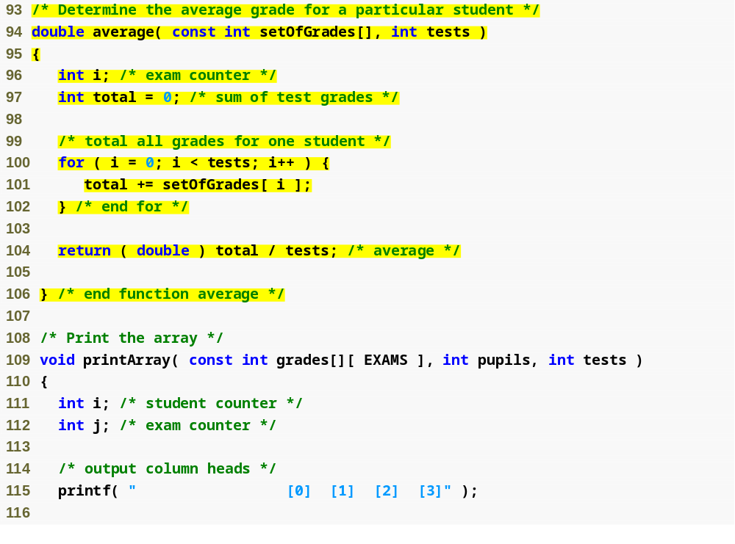

Slide 63
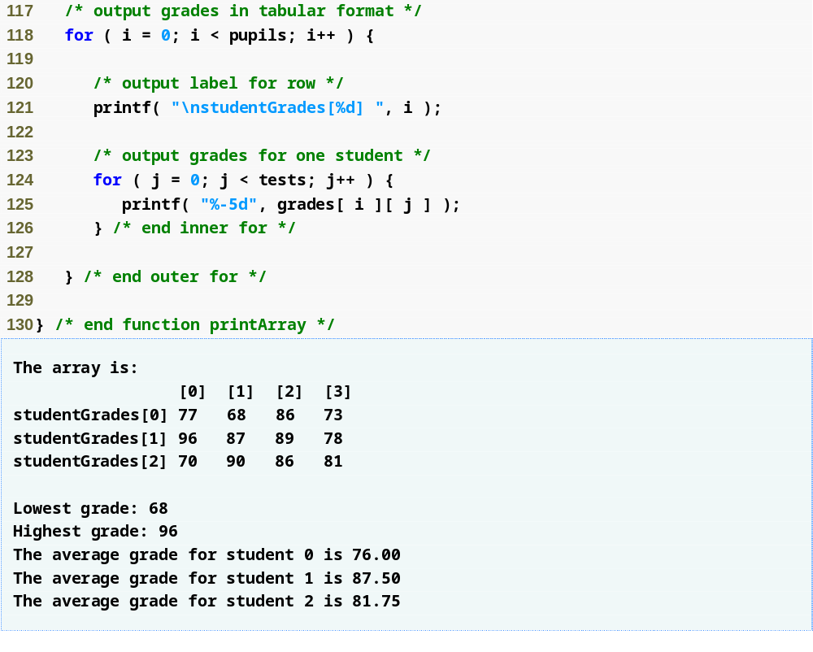

Slide 64
Referance
Ioannis A. Vetsikas, Lecture notes
Dale Roberts, Lecture notes

